Slide 1





Optical Characterization of Silver Nanocrystals on Silicon (100)
Michael Christiansen
21 April 2012
Mentor: Jeff Drucker
Drucker Lab Group: Jeff Drucker, Ph.D.;
Somilkumar Rathi; Dexin Kong

Slide 2
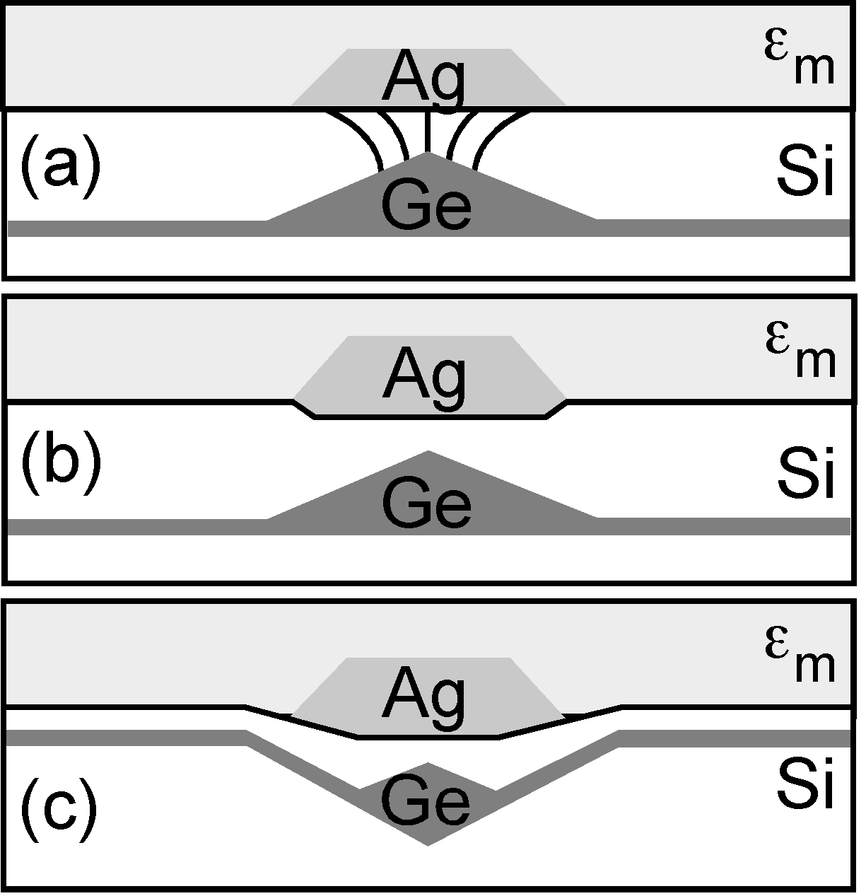
Motivation
There is a growing need for materials that interact with near infrared light at low loss communication frequencies.
Image Courtesy of Jeff Drucker
We are exploring the possibility of creating a nanocomposite material in which silver nanocrystals enhance the luminescence of Ge quantum dots.

Slide 3
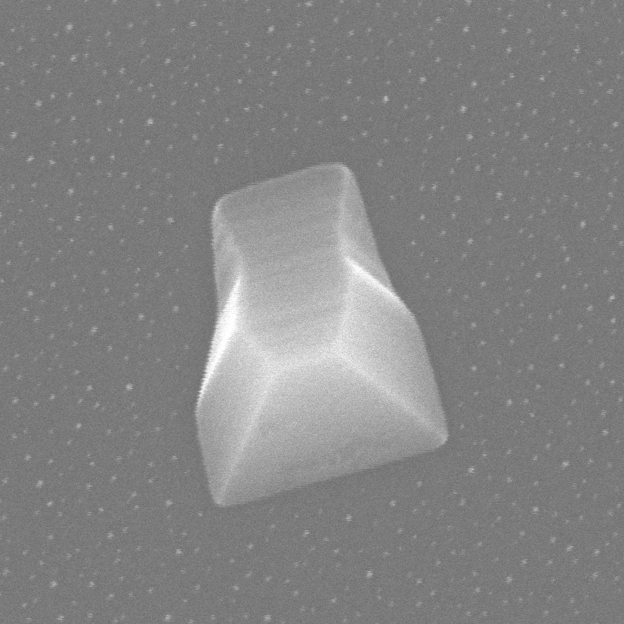
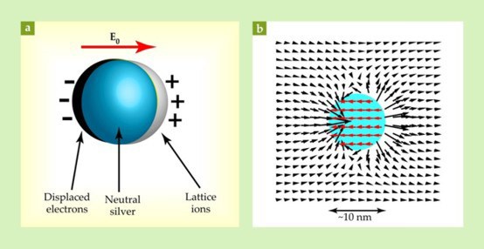
Silver Nanocrystals and
Plasmonic Resonance
A
250 nm
Stockman (2011)
Data collected by Dexin Kong

Slide 4
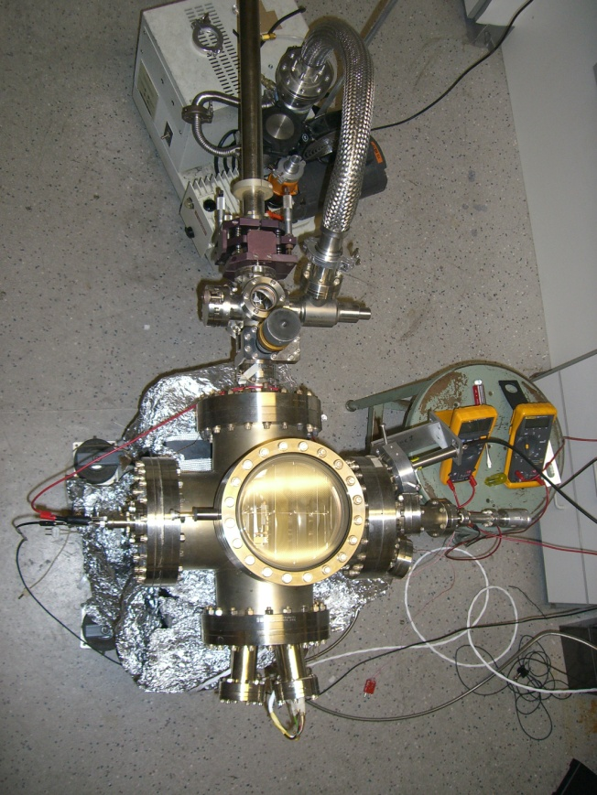
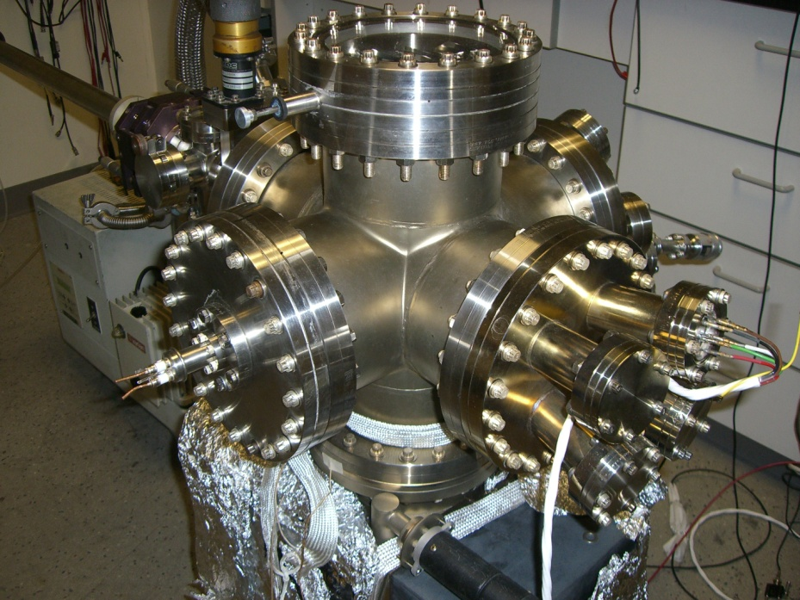
Sample Preparation
magnetically manipulated transfer rod
roughing and turbo pump assembly
load lock
gate valve
Pyrometer
Knudsen cell
main chamber
ion gauge
500nm

Slide 5
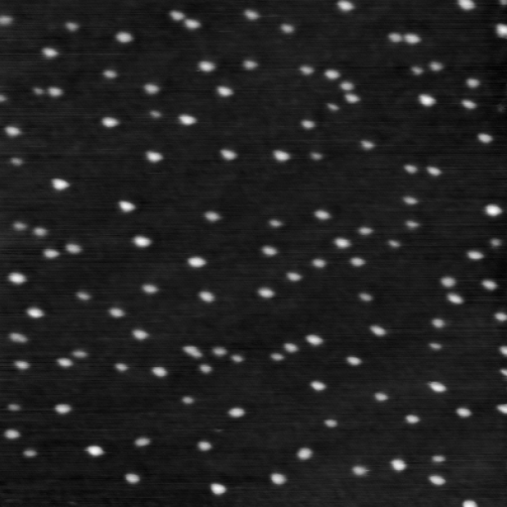
Optically Characterized Samples
1μm
1μm
250nm
6.9ML at 300°C
13.5ML at 300°C
1μm
1μm
2.5ML at 400°C
26ML at 300°C
2.5ML at 400°C
Data collected by Dexin Kong
500nm

Slide 6
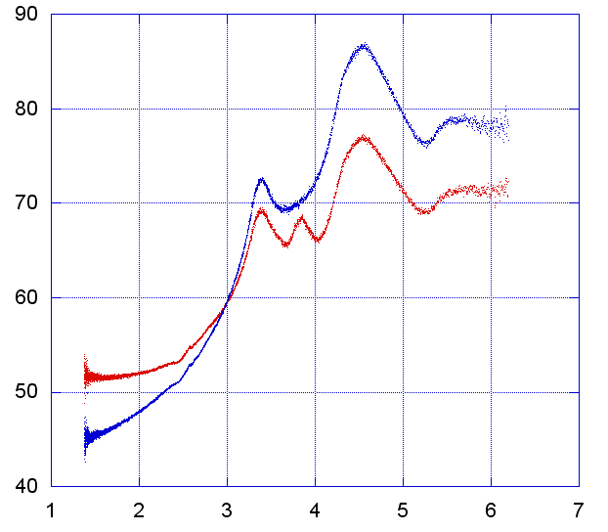
Raw Reflectance Data
Reflectance (Percent Intensity)
Photon Energy (eV)
500nm

Slide 7
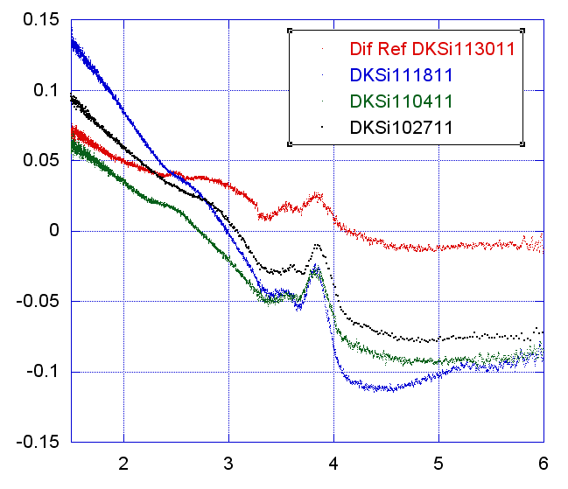
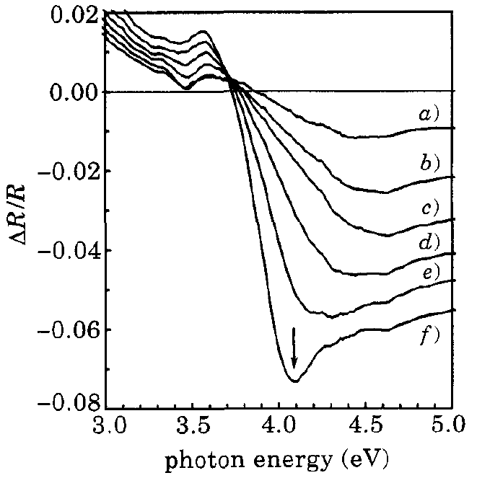
Differential Reflectance Results
6.9ML at 300°C
26ML at 300°C
∆R/R
2.5ML at 400°C
13.5ML at 300°C
(a)
(b)
(c)
(d)
Photon Energy (eV)
Y. Borensztein et. al. (1995)

Slide 8
Acknowledgements
Dr. Jeff Drucker
Dexin Kong
ASU NASA Space Grant
Use of ASU characterization facilities, especially those within the LeRoy Eyring Center for Solid State Science
Department of Physics Machine Shop
NSF grant for the overall project

Slide 9
Thanks for listening!
Questions?

